Slide 1
Unit – 5 Pandas

Slide 2
What is Pandas?
Pandas is an open source, BSD-licensed library providing high-performance, easy to use data structures and data analysis tools for Python programming language.

Slide 3
What is Data Science or Data Analytics?
Data science or data analytics is a process of analyzing large set of data points to get answers on questions related to that data set.
Pandas is a Python module that makes data science easy and effective.

Slide 4
Example – Weather Data
What was the maximum temperature in New York city in the month of January?
On which days did it rain?
What was the average wind speed during the month?

Slide 5
Why Pandas?
We can get answers to these using Excel itself.
But when the size of data points is large (millions of data points), it becomes harder to perform data analysis using Excel.
The next choice will be to use Python itself.
But this approach is not generic as we need to change the code every time to perform data analysis for different criteria.

Slide 6
Pandas Objects
Pandas objects can be thought of as enhanced versions of NumPy structured arrays in which the rows and columns are identified with labels rather than simple integer indices.
The three fundamental Pandas data structures are
Series,
DataFrame, and
Index.

Slide 7
The Pandas Series Object
A Pandas Series is a one-dimensional array of indexed data.
It can be created from a list or array as follows:
data = pd.Series([0.25, 0.5, 0.75, 1.0])
Series wraps both a sequence of values and a sequence of indices, which we can access with the values and index attributes.
data.values
data.index
Like with a NumPy array, data can be accessed by the associated index via the familiar Python square-bracket notation
data[1]
data[1:3]

Slide 8
NumPy array has an implicitly defined integer index used to access the values, the Pandas Series has an explicitly defined index associated with the values.
This explicit index definition gives the Series object additional capabilities. For example, the index need not be an integer, but can consist of values of any desired type.
data = pd.Series([0.25, 0.5, 0.75, 1.0], index=['a', 'b', 'c', 'd'])
We can even use noncontiguous or nonsequential indices.
data = pd.Series([0.25, 0.5, 0.75, 1.0], index=[2, 5, 3, 7])

Slide 9
Series as a dictionary
population_dict = {'California': 38332521, 'Texas': 26448193, 'New York': 19651127, 'Florida': 19552860, 'Illinois': 12882135}
population = pd.Series(population_dict)
population['California'] #displays pop of Cal
population['California':'Illinois'] #displays all

Slide 10
The Pandas DataFrame Object
Can be thought of either as
a generalization of a NumPy array, or
as a specialization of a Python dictionary

Slide 11
DataFrame as a generalized NumPy array
Series is an analog of a 1-D array with flexible indices.
A DataFrame is an analog of a two-dimensional array with both flexible row indices and flexible column names.
2-D array is as an ordered sequence of aligned 1-D columns
you can think of a DataFrame as a sequence of aligned Series objects.
Note: “Aligned" → share the same index.

Slide 12
DataFrame as a generalized NumPy array (Demo Code)
area_dict = {'California': 423967, 'Texas': 695662, 'New York': 141297, 'Florida': 170312, 'Illinois': 149995}
area = pd.Series(area_dict)
area
California 423967
Florida 170312
Illinois 149995
New York 141297
Texas 695662
dtype: int64

Slide 13
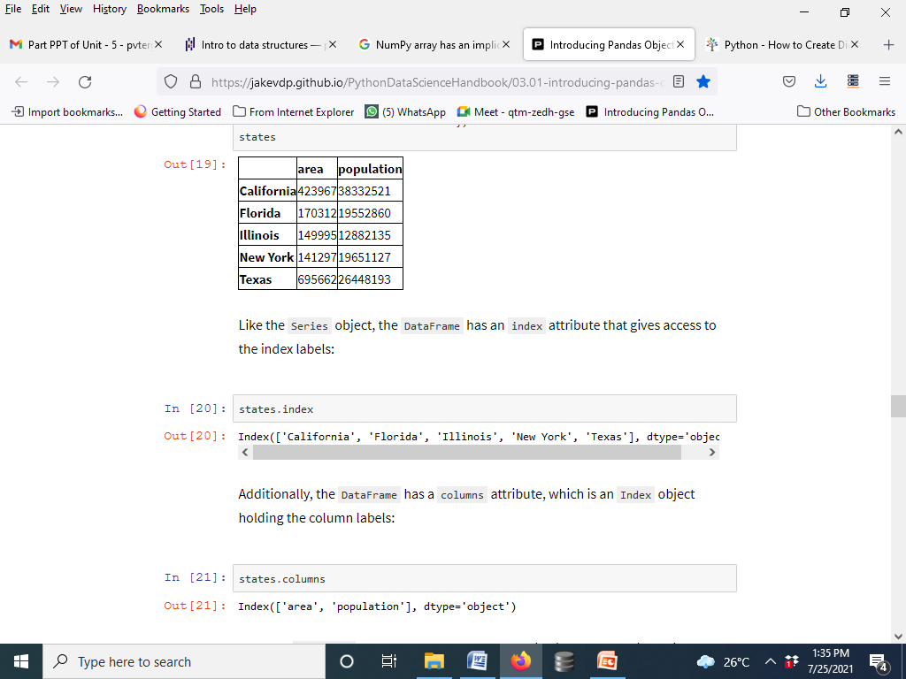
The Pandas DataFrame Object
population Series + area series → Use a dictionary to construct a single two-dimensional object containing this information:
Code
states = pd.DataFrame({'population': population, 'area': area})
states

Slide 14
Dataframe: Index and columns
states.index
Index(['California', 'Florida', 'Illinois', 'New York', 'Texas'], dtype='object')
states.columns
Index(['area', 'population'], dtype='object')

Slide 15
DataFrame as a dictionary
DataFrame
a specialization of a dictionary.
maps a column name to a Series of column data.
Example: 'area' attribute returns the Series object containing the areas:

Slide 16
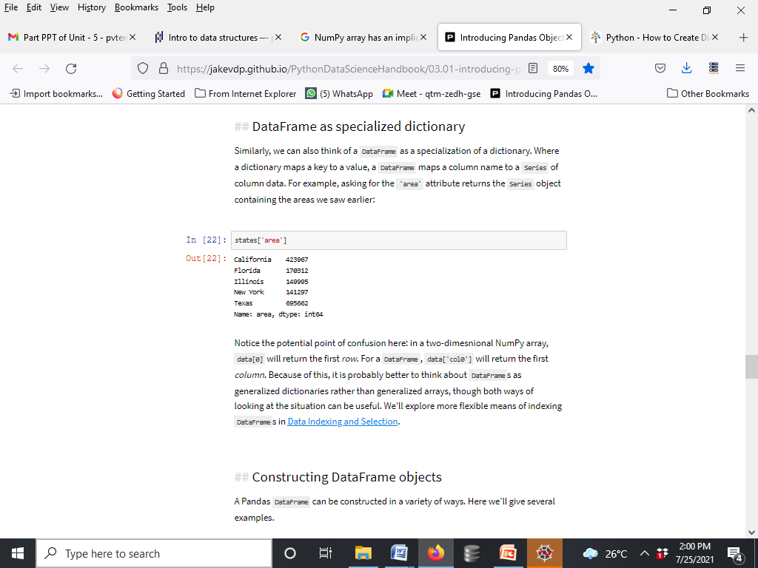
DataFrame as a dictionary
Note: 2D NumPy array,
data[0] will return the first row.
DataFrame:
data['col0'] will return the first column.

Slide 17
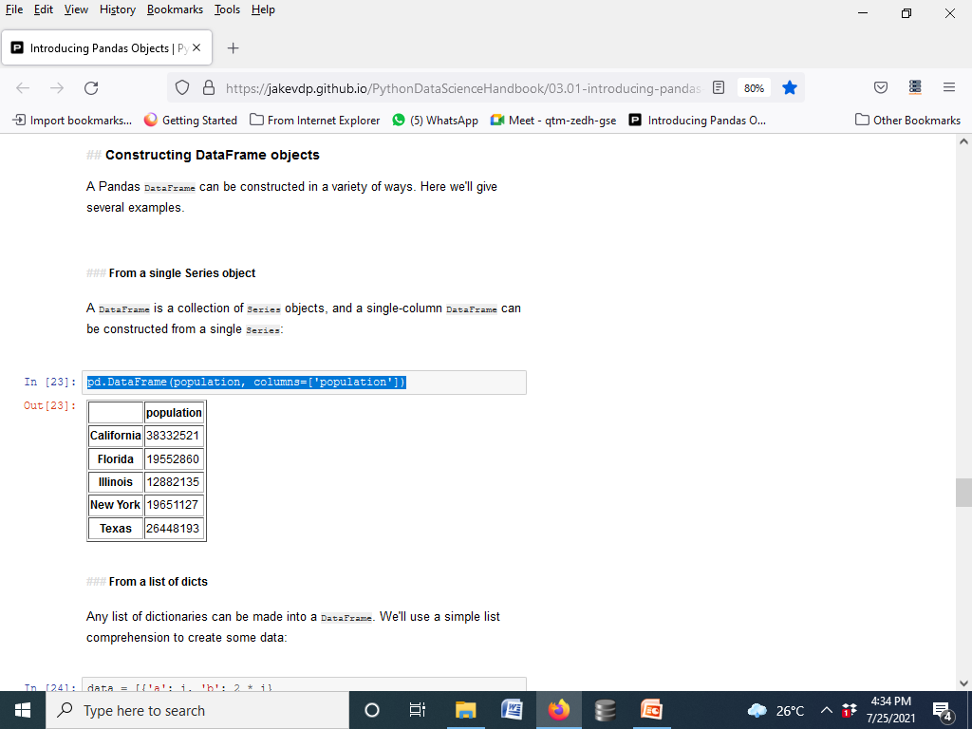
Constructing DataFrame objects
From a single Series object
A DataFrame is a collection of
Series objects, and a single-column DataFrame can be constructed from a single Series:
pd.DataFrame(population, columns=['population'])

Slide 18
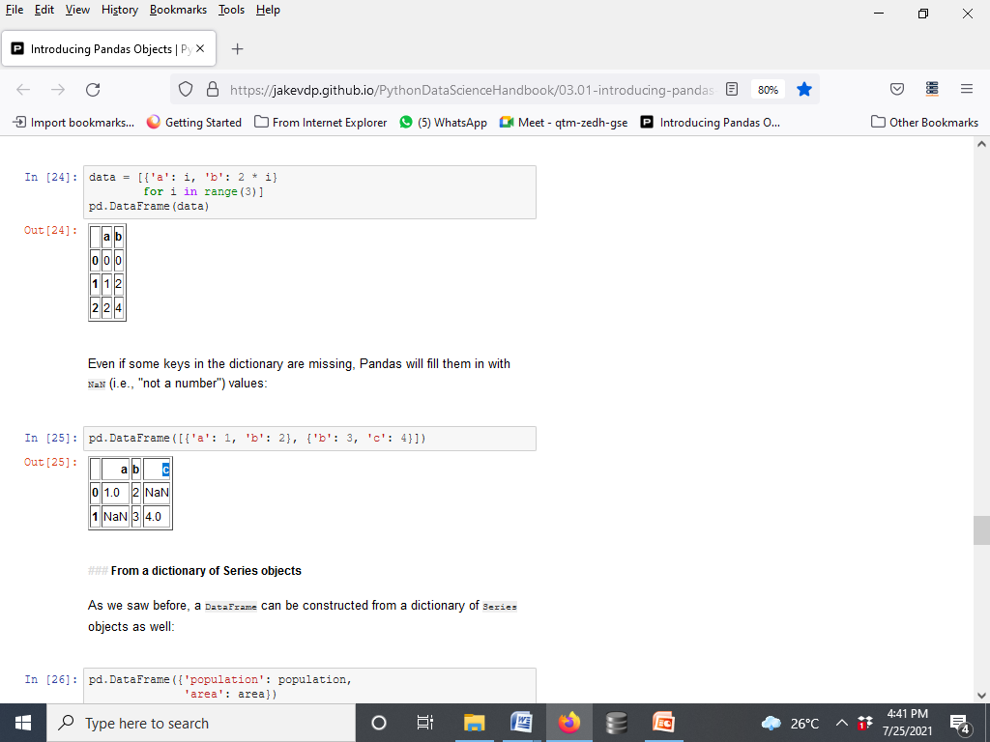

From a list of dicts
DataFrame → Any list of dictionaries
data = [{'a': i, 'b': 2 * i} for i in range(3)]
pd.DataFrame(data)
Note: if some keys in the dictionary are missing, Pandas will fill them in with NaN (i.e., "not a number") values:

Slide 19
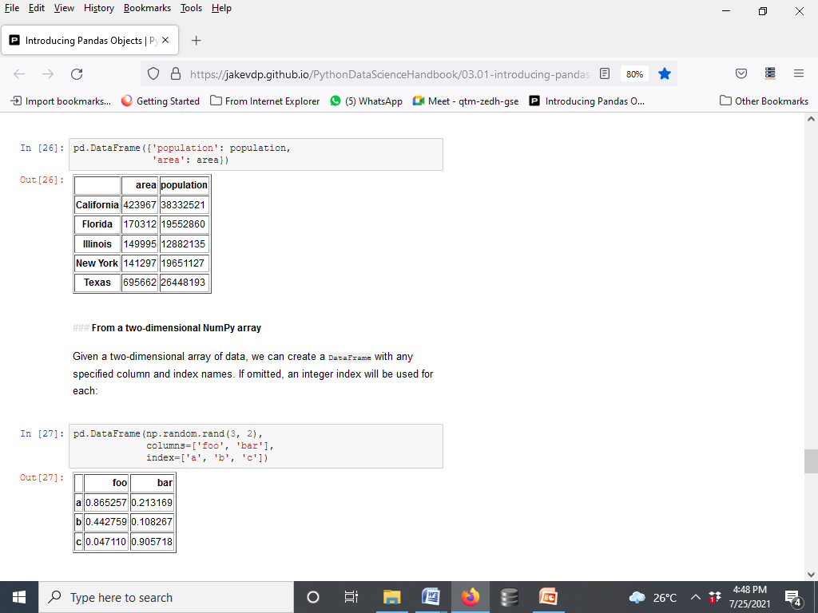
From a dictionary of Series objects
A DataFrame can be constructed from a dictionary of Series objects as well:
pd.DataFrame({'population': population, 'area': area})

Slide 20
From a two-dimensional NumPy array
Given a two-dimensional array of data, we can create a DataFrame with any specified column and index names. If omitted, an integer index will be used for each:
pd.DataFrame(np.random.rand(3, 2), columns=['foo', 'bar'],
index=['a', 'b', 'c'])

Slide 21
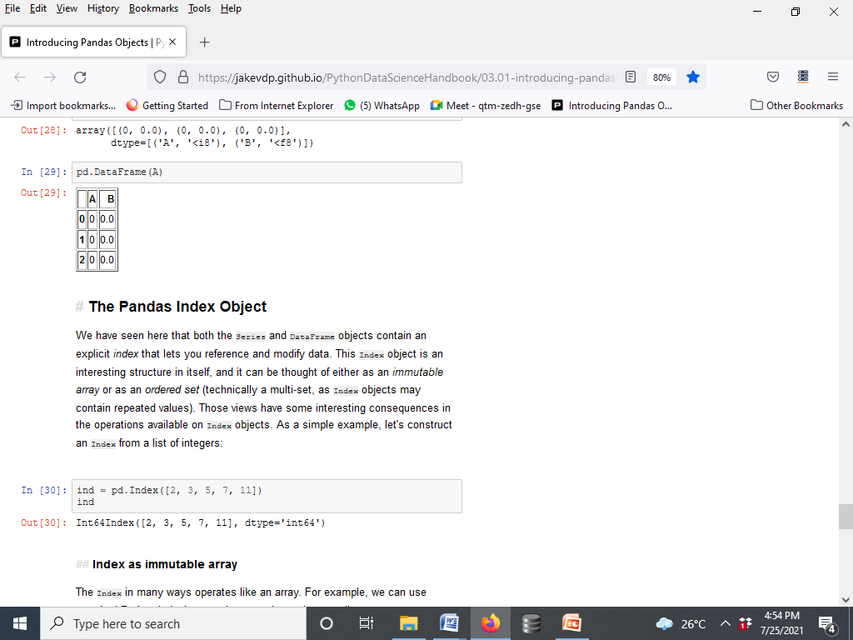
From a NumPy structured array
A Pandas DataFrame operates much like a structured array, and can be created directly from one:
A = np.zeros(3, dtype=[('A', 'i8'), ('B', 'f8')])
A
array([(0, 0.0), (0, 0.0), (0, 0.0)], dtype=[('A', '<i8'), ('B', '<f8')])
pd.DataFrame(A)

Slide 22
The Pandas Index Object
We have seen here that both the Series and DataFrame objects contain an explicit index that lets you reference and modify data.
This Index object is an interesting structure in itself, and it can be thought of either as an immutable array or as an ordered set (technically a multi-set, as Index objects may contain repeated values).
Example: An Index from a list of integers:
ind = pd.Index([2, 3, 5, 7, 11])
Ind → Int64Index([2, 3, 5, 7, 11], dtype='int64')

Slide 23
Index as immutable array
The Index in many ways operates like an array.
Example, we can use standard Python indexing notation to retrieve values or slices:
ind[1] → 3
ind[::2] → Int64Index([2, 5, 11], dtype='int64')
Index objects also have many of the attributes familiar from NumPy arrays:
print(ind.size, ind.shape, ind.ndim, ind.dtype) →5 (5,) 1 int64

Slide 24
Index as immutable array
One difference between Index objects and NumPy arrays is that indices are immutable–that is, they cannot be modified via the normal means:
ind[1] = 0
-TypeError Traceback (most recent call last) <ipython-input-34-40e631c82e8a> in <module>() ----> 1 ind[1] = 0 /Users/jakevdp/anaconda/lib/python3.5/site-packages/pandas/indexes/base.py in __setitem__(self, key, value) 1243 1244 def __setitem__(self, key, value): -> 1245 raise TypeError("Index does not support mutable operations") 1246 1247 def __getitem__(self, key):
This immutability makes it safer to share indices between multiple DataFrames and arrays, without the potential for side effects from inadvertent index modification.

Slide 25
Index as ordered set
Pandas objects are designed to facilitate operations such as joins across datasets, which depend on many aspects of set arithmetic. The Index object follows many of the conventions used by Python's built-in set data structure, so that unions, intersections, differences, and other combinations can be computed in a familiar way:
indA = pd.Index([1, 3, 5, 7, 9])
indB = pd.Index([2, 3, 5, 7, 11])
indA & indB → intersection [Int64Index([3, 5, 7], dtype='int64')]
indA | indB → union [Int64Index([1, 2, 3, 5, 7, 9, 11], dtype='int64')]
indA ^ indB → symmetric difference [Int64Index([1, 2, 9, 11], dtype='int64')]
These operations may also be accessed via object methods, for example indA.intersection(indB).

Slide 26
Handling missing data
The most time consuming part of a data science project is data cleaning and preparation →
Pandas powerful tools to expedite this process(data analysis)
Handling missing values
cleaning and preparation process because almost all data in real life comes with some missing values.

Slide 27
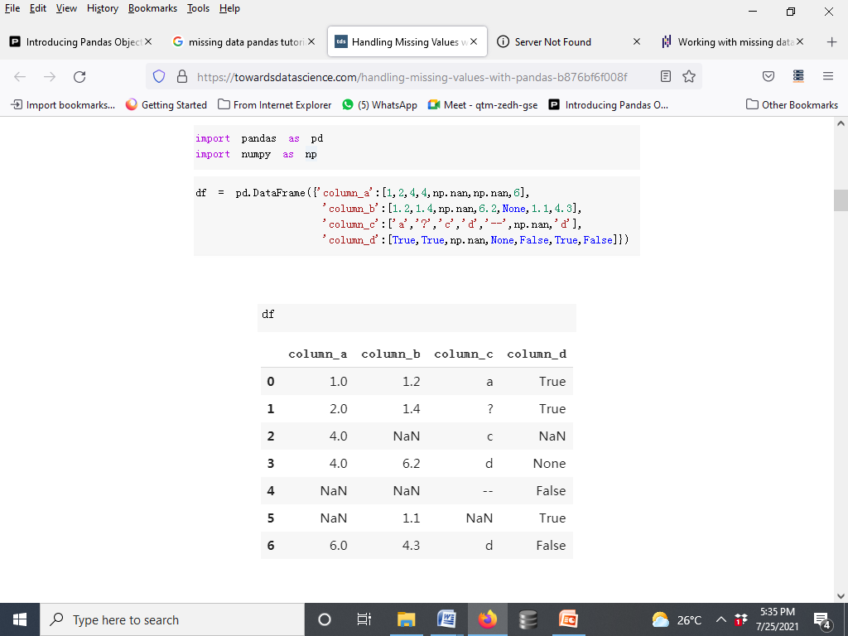
Handling Missing Values with Pandas
Create a dataframe with missing values first.
np.nan, None and NaT (for datetime64[ns] types) are standard missing value for Pandas.

Slide 28
Note: A new missing data type (<NA>) introduced with Pandas 1.0 which is an integer type missing value representation.
np.nan is float so if you use them in a column of integers, they will be upcast to floating-point data type as you can see in “column_a” of the dataframe we created.
However, <NA> can be used with integers without causing upcasting. Let’s add one more column to the dataframe using <NA> which can be used by explicitly requesting the dtype Int64Dtype().

Slide 29
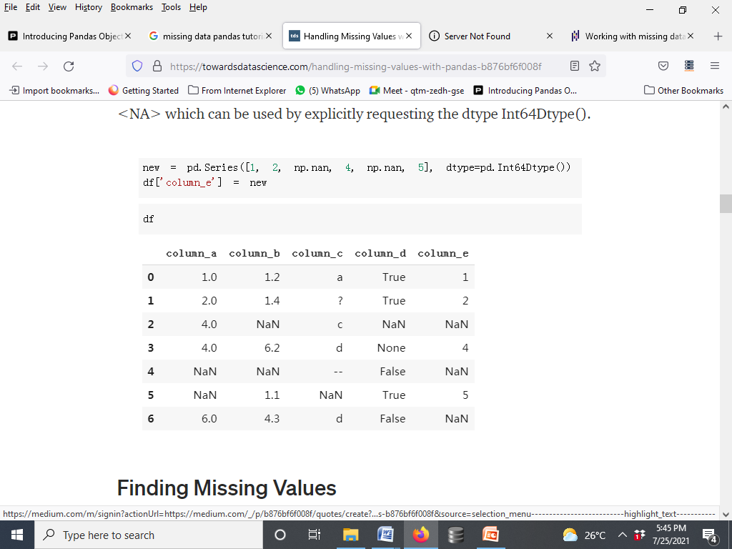

Slide 30
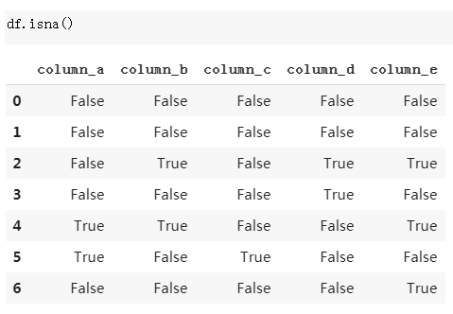
Finding Missing Values
Pandas provides isnull(), isna() functions to detect missing values. Both of them do the same thing.
df.isna() returns the dataframe with boolean values indicating missing values.

Slide 31
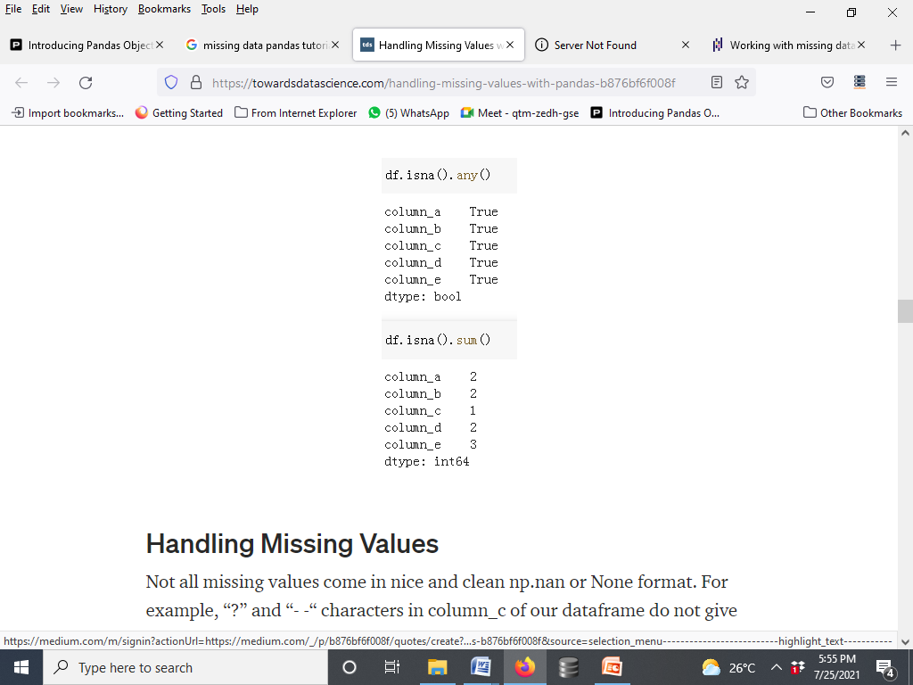
notna()
which is just the opposite of isna().
df.isna().any() returns a boolean value for each column.
If there is at least one missing value in that column, the result is True.
df.isna().sum()
returns the number of missing values in each column.

Slide 32
Handling Missing Values
Not all missing values come in nice and clean np.nan or None format.
For example, “?” and “- -“ characters in column_c of our dataframe do not give us any valuable information or insight so essentially they are missing values.
However, these characters cannot be detected as missing value by Pandas.
If we know what kind of characters used as missing values in the dataset, we can handle them while creating the dataframe using na_values parameter:

Slide 33
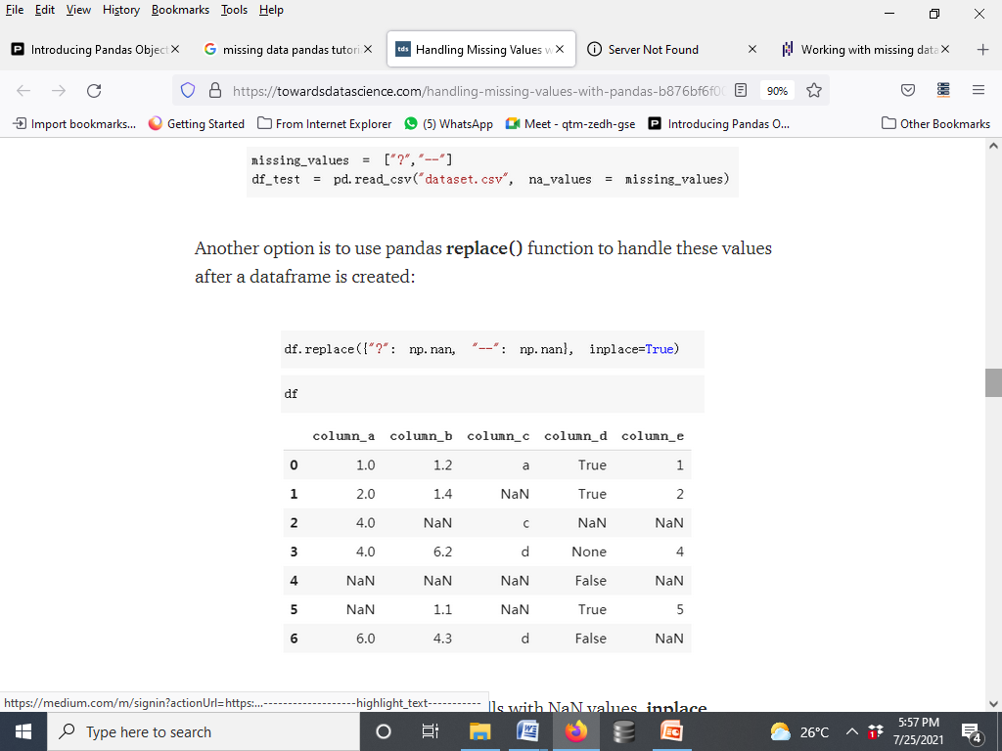
Handling Missing Values

Slide 34
Handling Missing Values
We have replaced non-informative cells with NaN values.
inplace parameter saves the changes in the dataframe.
Default value for inplace is False so if it is set it to True, changes will not be saved.
There is not an optimal way to handle missing values. Depending on the characteristics of the dataset and the task, we can choose to:
Drop missing values
Replace missing values

Slide 35
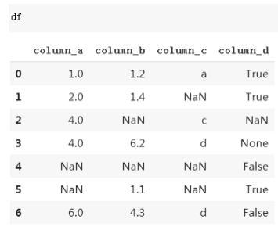
Drop missing values
We can drop a row or column with missing values using dropna() function. how parameter is used to set condition to drop.
how=’any’ : drop if there is any missing value
how=’all’ : drop if all values are missing
Furthermore, using thresh parameter, we can set a threshold for missing values in order for a row/column to be dropped.

Slide 36
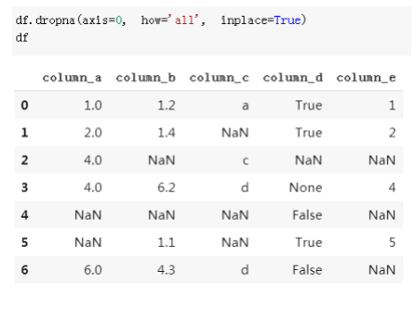
axis parameter is used to select row (0) or column (1).
Our dataframe do not have a row with full of missing values so setting how=’all’ did not drop any row. The default value is ‘any’ so we don’t need to specify it if we want to use how=’any’:
Drop missing values

Slide 37
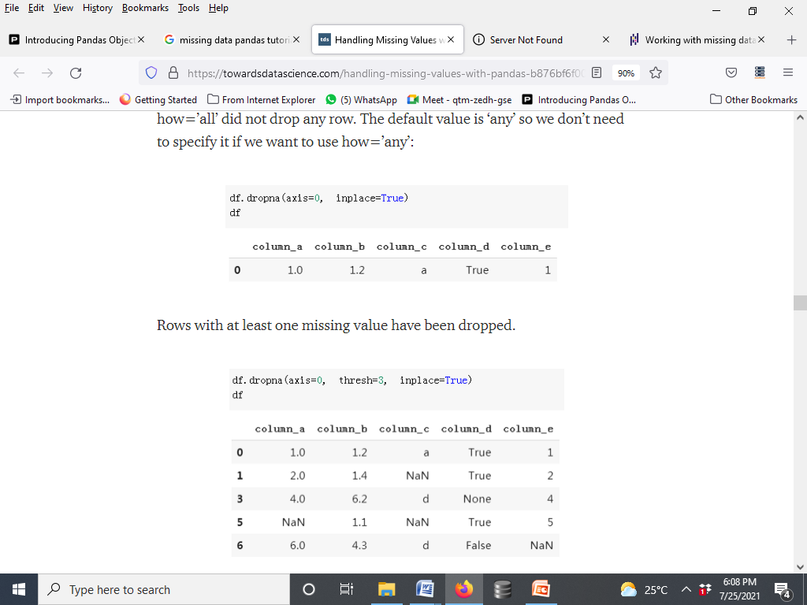
Drop missing values
Setting thresh parameter to 3 dropped rows with at least 3 missing values.

Slide 38
Replacing missing values
fillna() function of Pandas conveniently handles missing values.
Using fillna(), missing values can be replaced by a special value or an aggreate value such as mean, median.
Furthermore, missing values can be replaced with the value before or after it which is pretty useful for time-series datasets.
Replace missing values with a scalar:

Slide 39
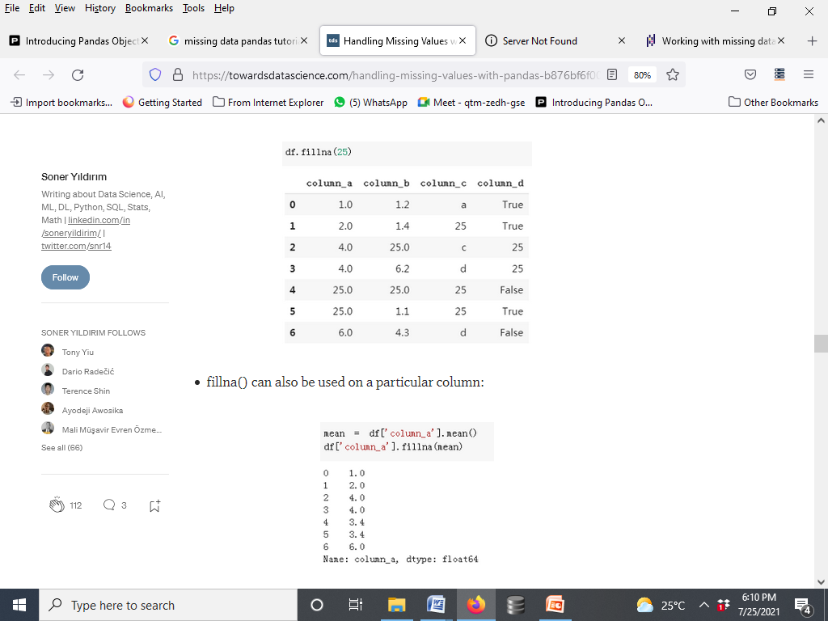

Slide 40
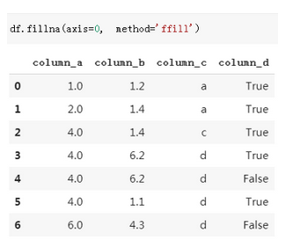
Using method parameter, missing values can be replaced with the values before or after them.

Slide 41
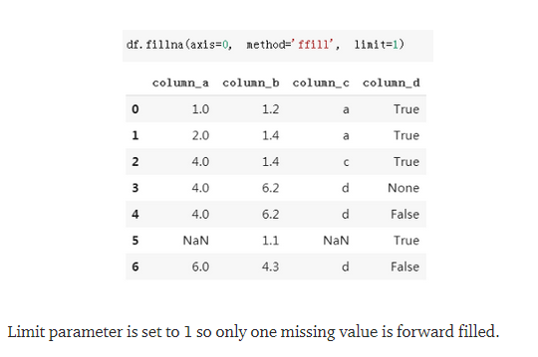
ffill stands for “forward fill” replaces missing values with the values in the previous row. You can also choose bfill which stands for “backward fill”.
If there are many consecutive missing values in a column or row, you may want to limit the number of missing values to be forward or backward filled.

Slide 42
Pivot basics
import pandas as pd
import numpy as np
df = pd.read_csv("weather.csv")
 | date | city | temperature | humidity
0 | 5/1/2017 | new york | 65 | 56
1 | 5/2/2017 | new york | 66 | 58
2 | 5/3/2017 | new york | 68 | 60
3 | 5/1/2017 | mumbai | 75 | 80
4 | 5/2/2017 | mumbai | 78 | 83
5 | 5/3/2017 | mumbai | 82 | 85
6 | 5/1/2017 | beijing | 80 | 26
7 | 5/2/2017 | beijing | 77 | 30
8 | 5/3/2017 | beijing | 79 | 35

Slide 43
df.pivot(index='city',columns='date')
 | temperature |  |  | humidity
date | 5/1/2017 | 5/2/2017 | 5/3/2017 | 5/1/2017 | 5/2/2017 | 5/3/2017
city
beijing | 80 | 77 | 79 | 26 | 30 | 35
mumbai | 75 | 78 | 82 | 80 | 83 | 85
new york | 65 | 66 | 68 | 56 | 58 | 60

Slide 44
date | 5/1/2017 | 5/2/2017 | 5/3/2017
city
beijing | 26 | 30 | 35
mumbai | 80 | 83 | 85
new york | 56 | 58 | 60
df.pivot(index='city',columns='date',values="humidity")
df.pivot(index='date',columns='city')
 | temperature |  |  | humidity
city | beijing | mumbai | new york | beijing | mumbai | new york
date
5/1/2017 | 80 | 75 | 65 | 26 | 80 | 56
5/2/2017 | 77 | 78 | 66 | 30 | 83 | 58
5/3/2017 | 79 | 82 | 68 | 35 | 85 | 60

Slide 45
df.pivot(index='humidity',columns='city')
 | date |  |  | temperature
city | beijing | mumbai | new york | beijing | mumbai | new york
humidity
26 | 5/1/2017 | None | None | 80.0 | NaN | NaN
30 | 5/2/2017 | None | None | 77.0 | NaN | NaN
35 | 5/3/2017 | None | None | 79.0 | NaN | NaN
56 | None | None | 5/1/2017 | NaN | NaN | 65.0
58 | None | None | 5/2/2017 | NaN | NaN | 66.0
60 | None | None | 5/3/2017 | NaN | NaN | 68.0
80 | None | 5/1/2017 | None | NaN | 75.0 | NaN
83 | None | 5/2/2017 | None | NaN | 78.0 | NaN
85 | None | 5/3/2017 | None | NaN | 82.0 | NaN

Slide 46
Pivot Table
df = pd.read_csv("weather2.csv")
df
 | date | city | temperature | humidity
0 | 5/1/2017 | new york | 65 | 56
1 | 5/1/2017 | new york | 61 | 54
2 | 5/2/2017 | new york | 70 | 60
3 | 5/2/2017 | new york | 72 | 62
4 | 5/1/2017 | mumbai | 75 | 80
5 | 5/1/2017 | mumbai | 78 | 83
6 | 5/2/2017 | mumbai | 82 | 85
7 | 5/2/2017 | mumbai | 80 | 26

Slide 47
df.pivot_table(index="city",columns="date")
 | humidity |  | temperature
date | 5/1/2017 | 5/2/2017 | 5/1/2017 | 5/2/2017
city
mumbai | 81.5 | 55.5 | 76.5 | 81.0
new york | 55.0 | 61.0 | 63.0 | 71.0

Slide 48
Margins
df.pivot_table(index="city",columns="date", margins=True,aggfunc=np.sum)
 | humidity |  |  |  | temperature
date | 5/1/2017 | 5/2/2017 | 5/3/2017 | All | 5/1/2017 | 5/2/2017 | 5/3/2017 | All
city
beijing | 26.0 | 30.0 | 35.0 | 91.0 | 80.0 | 77.0 | 79.0 | 236.0
mumbai | 80.0 | 83.0 | 85.0 | 248.0 | 75.0 | 78.0 | 82.0 | 235.0
new york | 110.0 | 122.0 | 60.0 | 292.0 | 126.0 | 142.0 | 68.0 | 336.0
All | 216.0 | 235.0 | 180.0 | 631.0 | 281.0 | 297.0 | 229.0 | 807.0

Slide 49
Grouper
df = pd.read_csv("weather3.csv")
df
 | date | city | temperature | humidity
0 | 5/1/2017 | new york | 65 | 56
1 | 5/2/2017 | new york | 61 | 54
2 | 5/3/2017 | new york | 70 | 60
3 | 12/1/2017 | new york | 30 | 50
4 | 12/2/2017 | new york | 28 | 52
5 | 12/3/2017 | new york | 25 | 51

Slide 50
df['date'] = pd.to_datetime(df['date'])
df.pivot_table(index=pd.Grouper(freq='M',key='date'),columns='city')
 | humidity | temperature
city | new york | new york
date
2017-05-31 | 56.666667 | 65.333333
2017-12-31 | 51.000000 | 27.666667

Slide 51
Concat
import pandas as pd
india_weather = pd.DataFrame({
"city": ["mumbai","delhi","banglore"],
"temperature": [32,45,30],
"humidity": [80, 60, 78]
})
india_weather
 | city | humidity | temperature
0 | mumbai | 80 | 32
1 | delhi | 60 | 45
2 | banglore | 78 | 30

Slide 52
us_weather = pd.DataFrame({
"city": ["new york","chicago","orlando"],
"temperature": [21,14,35],
"humidity": [68, 65, 75]
})
us_weather
 | city | humidity | temperature
0 | new york | 68 | 21
1 | chicago | 65 | 14
2 | orlando | 75 | 35

Slide 53
df = pd.concat([india_weather, us_weather])
df
 | city | humidity | temperature
0 | mumbai | 80 | 32
1 | delhi | 60 | 45
2 | banglore | 78 | 30
0 | new york | 68 | 21
1 | chicago | 65 | 14
2 | orlando | 75 | 35

Slide 54
df = pd.concat([india_weather, us_weather], ignore_index=True)
df
 | city | humidity | temperature
0 | mumbai | 80 | 32
1 | delhi | 60 | 45
2 | banglore | 78 | 30
3 | new york | 68 | 21
4 | chicago | 65 | 14
5 | orlando | 75 | 35

Slide 55
df = pd.concat([india_weather, us_weather], keys=["india", "us"])
df
 |  | city | humidity | temperature
india | 0 | mumbai | 80 | 32
 | 1 | delhi | 60 | 45
 | 2 | banglore | 78 | 30
us | 0 | new york | 68 | 21
 | 1 | chicago | 65 | 14
 | 2 | orlando | 75 | 35

Slide 56
df.loc["us"]
 | city | humidity | temperature
0 | new york | 68 | 21
1 | chicago | 65 | 14
2 | orlando | 75 | 35
df.loc["india"]
 | city | humidity | temperature
0 | mumbai | 80 | 32
1 | delhi | 60 | 45
2 | banglore | 78 | 30

Slide 57
 | city | temperature
0 | mumbai | 32
1 | delhi | 45
2 | banglore | 30
temperature_df = pd.DataFrame({
"city": ["mumbai","delhi","banglore"],
"temperature": [32,45,30],
}, index=[0,1,2])
temperature_df
windspeed_df = pd.DataFrame({
"city": ["delhi","mumbai"],
"windspeed": [7,12],
}, index=[1,0])
windspeed_df
 | city | windspeed
1 | delhi | 7
0 | mumbai | 12

Slide 58
 | city | temperature | city | windspeed
0 | mumbai | 32 | mumbai | 12.0
1 | delhi | 45 | delhi | 7.0
2 | banglore | 30 | NaN | NaN
df = pd.concat([temperature_df,
windspeed_df],axis=1)
Df
s = pd.Series(["Humid","Dry","Rain"], name="event")
S
0 Humid
1 Dry
Rain
Name: event, dtype: object

Slide 59
df = pd.concat([temperature_df,s],axis=1)
df
 | city | temperature | event
0 | mumbai | 32 | Humid
1 | delhi | 45 | Dry
2 | banglore | 30 | Rain

Slide 60
Merge
 | city | temperature
0 | new york | 21
1 | chicago | 14
2 | orlando | 35
import pandas as pd
df1 = pd.DataFrame({
"city": ["new york","chicago","orlando"],
"temperature": [21,14,35],
})
df1
df2 = pd.DataFrame({
"city": ["chicago","new york","orlando"],
"humidity": [65,68,75],
})
df2
 | city | humidity
0 | chicago | 65
1 | new york | 68
2 | orlando | 75

Slide 61
df3 = pd.merge(df1, df2, on="city")
Df3
df1 = pd.DataFrame({
"city": ["new york","chicago","orlando", "baltimore"],
"temperature": [21,14,35, 38],
})
Df1
df2 = pd.DataFrame({
"city": ["chicago","new york","san diego"],
"humidity": [65,68,71],
})
df2
 | city | temperature | humidity
0 | new york | 21 | 68
1 | chicago | 14 | 65
2 | orlando | 35 | 75
 | city | temperature
0 | new york | 21
1 | chicago | 14
2 | orlando | 35
3 | baltimore | 38
 | city | humidity
0 | chicago | 65
1 | new york | 68
2 | san diego | 71

Slide 62
 | city | temperature | humidity
0 | new york | 21 | 68
1 | chicago | 14 | 65
df3=pd.merge(df1,df2,on="city",how="inner")
df3
df3=pd.merge(df1,df2,on="city",how="outer")
df3
df3=pd.merge(df1,df2,on="city",how="left")
Df3
 | city | temperature | humidity
0 | new york | 21.0 | 68.0
1 | chicago | 14.0 | 65.0
2 | orlando | 35.0 | NaN
3 | baltimore | 38.0 | NaN
4 | san diego | NaN | 71.0
 | city | temperature | humidity
0 | new york | 21 | 68.0
1 | chicago | 14 | 65.0
2 | orlando | 35 | NaN
3 | baltimore | 38 | NaN

Slide 63
df3=pd.merge(df1,df2,on="city",how="right")
df3
df3=pd.merge(df1,df2,on="city",how="outer",indicator=True)
df3
 | city | temperature | humidity
0 | new york | 21.0 | 68
1 | chicago | 14.0 | 65
2 | san diego | NaN | 71
 | city | temperature | humidity | _merge
0 | new york | 21.0 | 68.0 | both
1 | chicago | 14.0 | 65.0 | both
2 | orlando | 35.0 | NaN | left_only
3 | baltimore | 38.0 | NaN | left_only
4 | san diego | NaN | 71.0 | right_only

Slide 64
df1 = pd.DataFrame({
"city": ["new york","chicago","orlando", "baltimore"],
"temperature": [21,14,35,38],
"humidity": [65,68,71, 75]
})
df1
df2 = pd.DataFrame({
"city": ["chicago","new york","san diego"],
"temperature": [21,14,35],
"humidity": [65,68,71]
})
df2
 | city | humidity | temperature
0 | new york | 65 | 21
1 | chicago | 68 | 14
2 | orlando | 71 | 35
3 | baltimore | 75 | 38
 | city | humidity | temperature
0 | chicago | 65 | 21
1 | new york | 68 | 14
2 | san diego | 71 | 35

Slide 65
 | city | humidity_first | temperature_first | humidity_second | temperature_second
0 | new york | 65.0 | 21.0 | 68.0 | 14.0
1 | chicago | 68.0 | 14.0 | 65.0 | 21.0
2 | orlando | 71.0 | 35.0 | NaN | NaN
3 | baltimore | 75.0 | 38.0 | NaN | NaN
4 | san diego | NaN | NaN | 71.0 | 35.0
df3= pd.merge(df1,df2,on="city",how="outer", suffixes=('_first','_second'))
df3
df1 = pd.DataFrame({
"city": ["new york","chicago",
"orlando"],
"temperature": [21,14,35],
})
df1.set_index('city',inplace=True)
df1
 | temperature
city
new york | 21
chicago | 14
orlando | 35

Slide 66
 | humidity
city
chicago | 65
new york | 68
orlando | 75
df2 = pd.DataFrame({
"city": ["chicago","new york","orlando"],
"humidity": [65,68,75],
})
df2.set_index('city',inplace=True)
df2
df1.join(df2,lsuffix='_l', rsuffix='_r')
 | temperature | humidity
city
new york | 21 | 68
chicago | 14 | 65
orlando | 35 | 75

